Slide 1

Project Pitch
V-OAR
The INT-stigators

Slide 2

James Farrell
Project Lead [Main]
VR Development
Sound Design
Level Scripting [Secondary-Aid]
Keelan Murphy
3D Modelling [Main]
3D Animation
Texture Design
UI Design [Secondary-Aid]
Nathan Hill
Scrum Master [Main]
Game Design
UI Design
Sound Design [Secondary-Aid]
Kristine Saroka
Level Scripting [Main]
Level Design
Testing
VR Development and UI Design [Secondary-Aid]
Our Team

Slide 3





Technologies
Notes:
It provides a large file storage system (LFS) which allows us to upload Unity scene files.

Slide 4
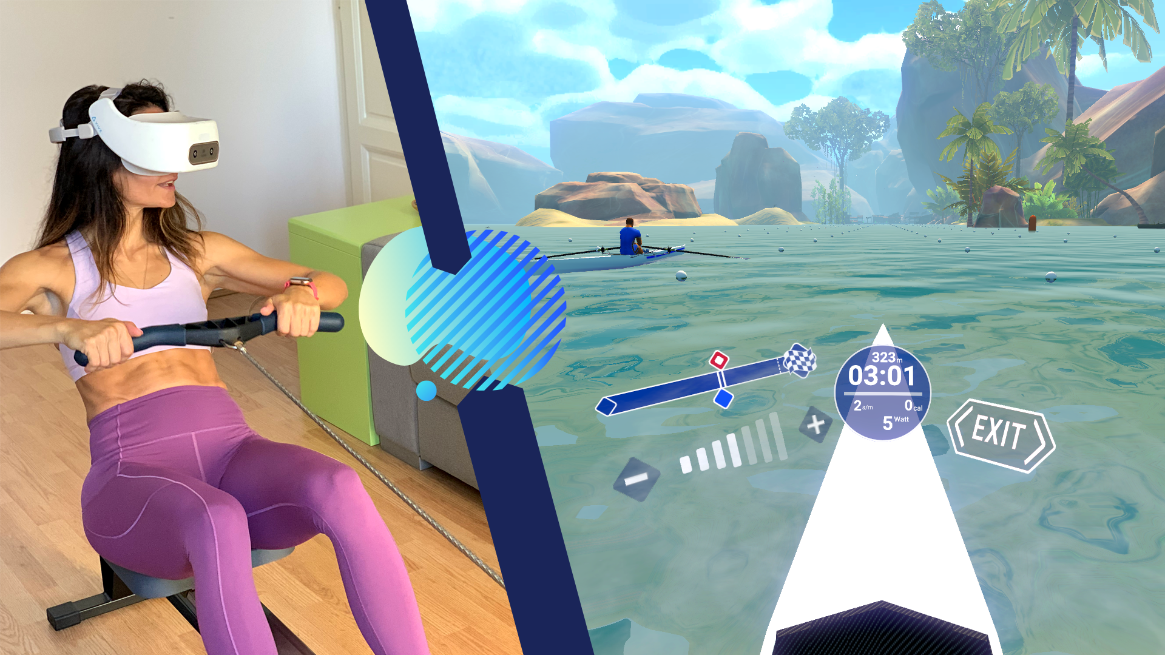
V-OAR is a virtual reality rowing experience, which transforms a typical workout into explorations of an open world
Game Idea
Combining virtual reality with physical interactions
HOLOFIT VR (HOLODIA)

Slide 5
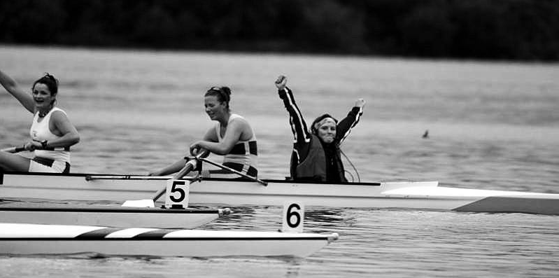
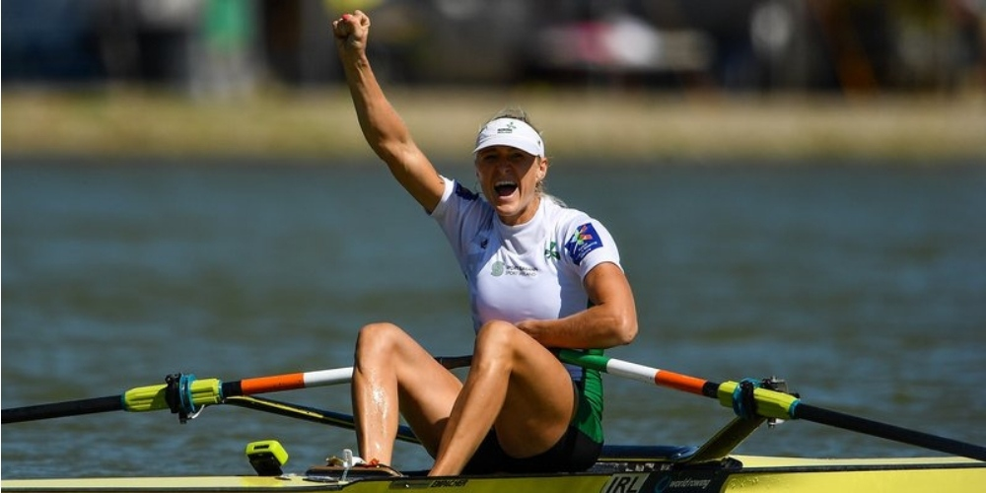
Primary Target Group
Frequent and experienced rowers, who are typically part of a club or a team.
Demographic
Primary Target
Subsequent Group
Potential Group
Objective
Provide an alternative to traditional rowing when external factors prevent them from doing so, such as weather, injuries, or unexpected global pandemics. We also hope to improve their experience by submerse them with a surreal environment.

Slide 6

Subsequent Groups
Individuals who are aiming to keep fit from home but require a source of motivation.
Demographic
Primary Target
Subsequent Group
Potential Group
Objective
Provide an engaging domain for the player to motivate them in their pursuit to keep fit. Captivate their interest with the prospect of achievements and challenging their friends to competitive racing.

Slide 7
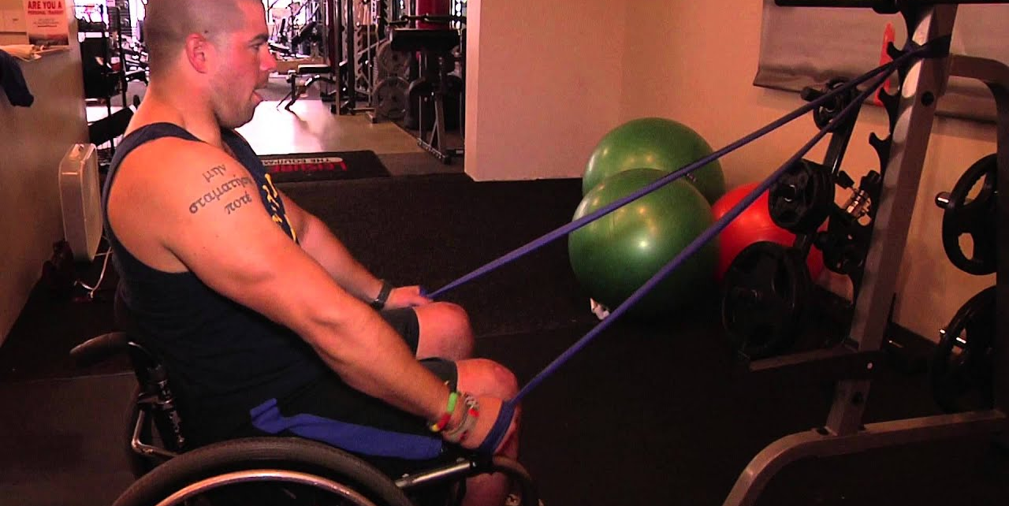
Potential Groups
Individuals that have restricted lower body movements, be it temporary or long-term.
Demographic
Primary Target
Subsequent Group
Potential Group
Objective
Provide an opportunity to grasp the sensation of exploration, enable them to exercise from the comfort of their home with less setup requirements and perhaps serve as a form of escapism.

Slide 8
Clubs Contacted
Limiting our reach to the country. The following clubs were contacted:
Silver Bridge Kayak Club | Kayaking, Outdoor Activities
Dún Laoghaire Rowing | Competitive & Leisurely Rowing
Skerries Rowing Club| Traditional Row Boats, Skiff Rowing
Fingal Rowing Club | Fundraiser Rowing Challenges
Inver Colpa Rowing Club | River Rowing
Contacting
Rowing
Clubs
Clubs Contacted
Feedback

Slide 9
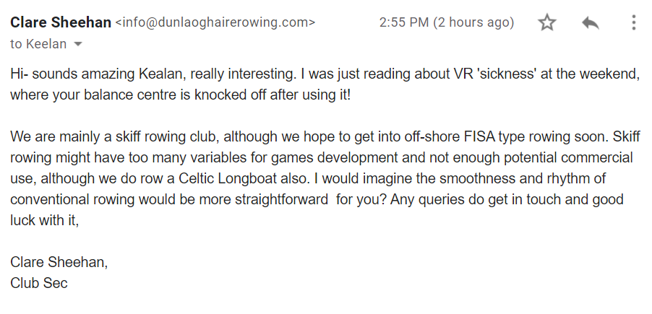
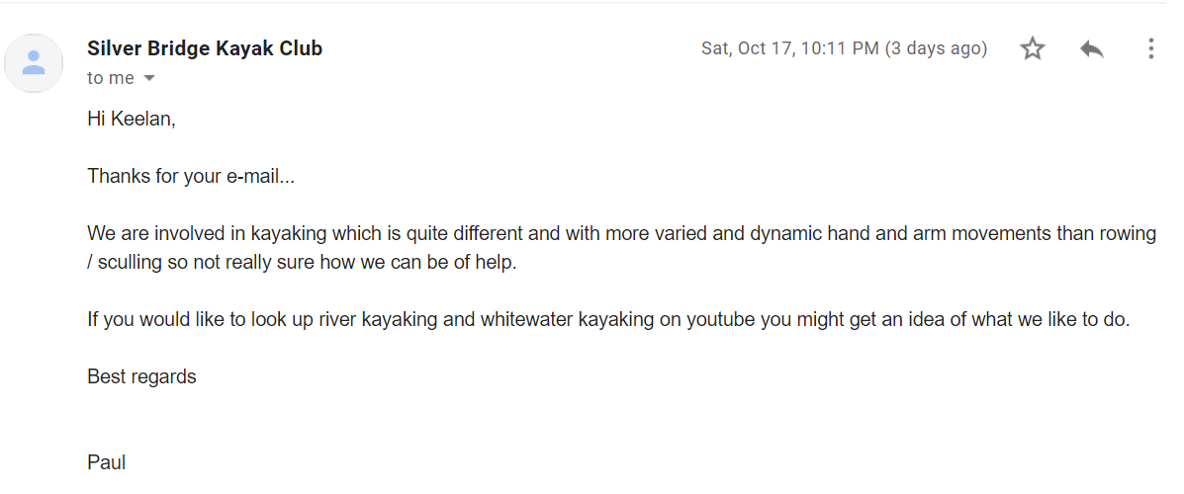
Feedback Received
Thus far, we have acquired the following intelligence:
Contacting
Rowing
Clubs
Clubs Contacted
Feedback

Slide 10
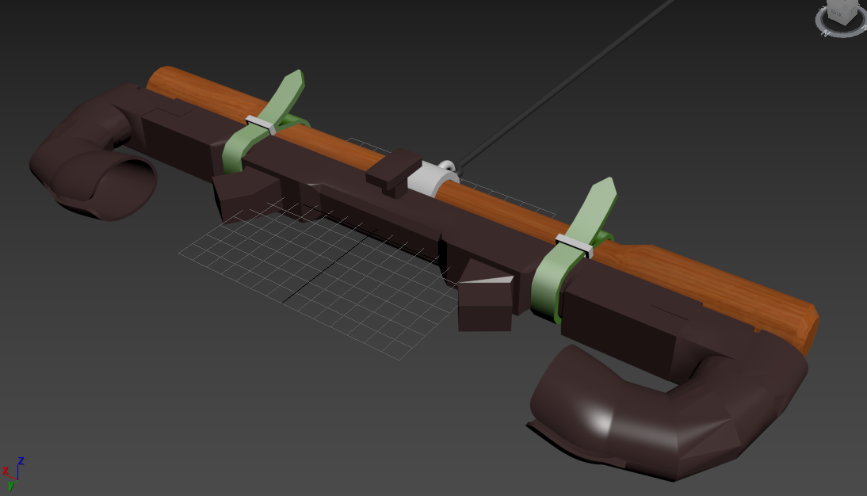
VR Attachment
Attachment designed for holding the set of VR controllers angled in a specific way to help the user hold the controllers and aid them in their movements.
Game
Controls
VR Attachment
Rowing Machine
Resistance Band
Description
The attachment will contain a set of straps for harnessing it atop a rowing machine handle and a hook for securing bands or ropes.

Slide 11
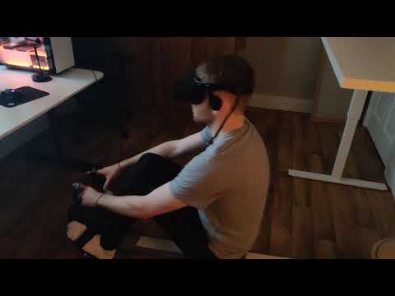
Game
Controls
VR Attachment
Rowing Machine
Resistance Band
Rowing Machine
Initially, rowing machine users were our primary target that bared life to this game's idea. Despite our demographic taking a change to include a larger audience. The rowing machine remains as a feasible and compatible device to playing this game.

Slide 12
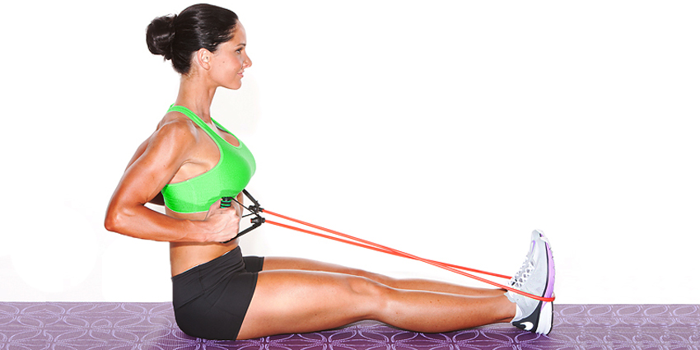
Game
Controls
VR Attachment
Rowing Machine
Resistance Band
Resistance Bands
To avoid making the game too exclusive, the resistance band would be a good alternative to the rowing machine, which would be much easier to obtain within the average household.

Slide 13

Exploratory Mode
Player explores an open-world lake with various hubs linking to our training modes.
Modes &
Mechanics
Exploratory
Training
Time Trials
Race
Objective
To provide a relaxing environment for the player to explore.

Slide 14
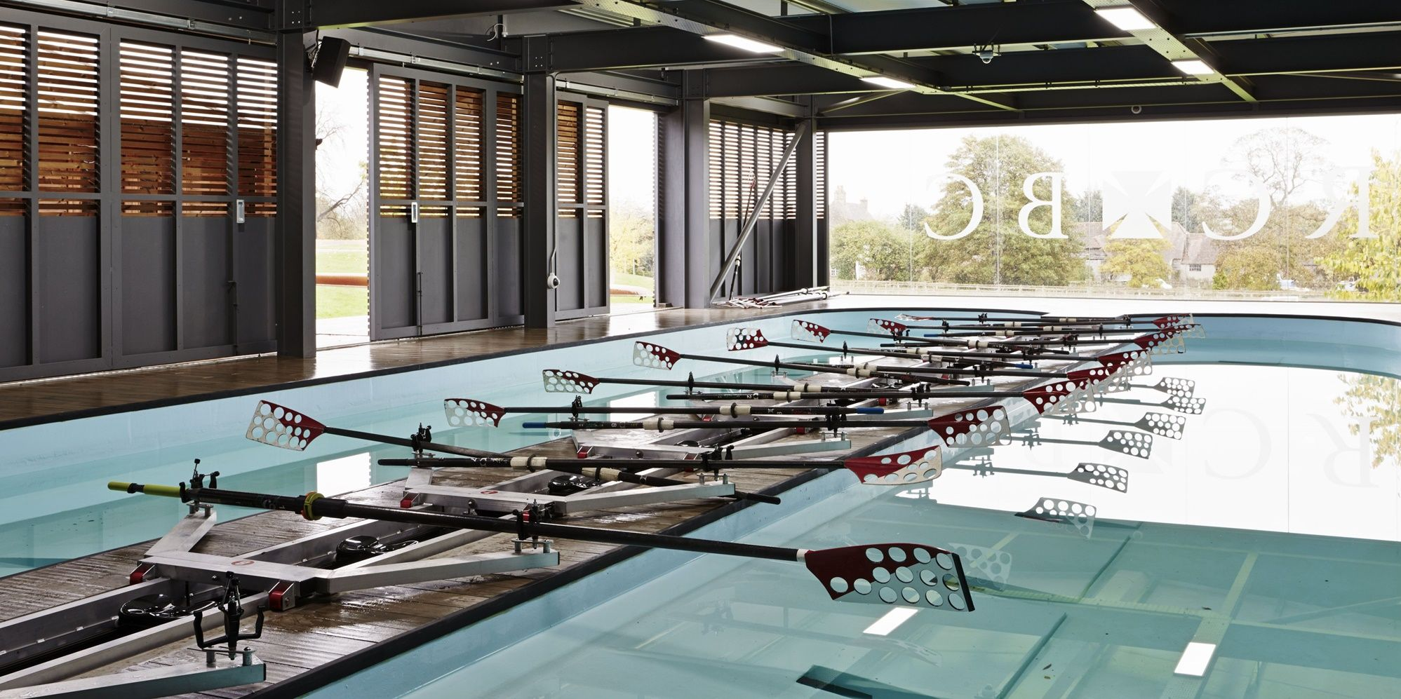
Training Mode
Player rows a stationary boat, while a virtual coach encourages them.
Modes &
Mechanics
Exploratory
Training
Time Trials
Race
Objective
To provide a virtual training environment which allows the player to enhance their skills.

Slide 15
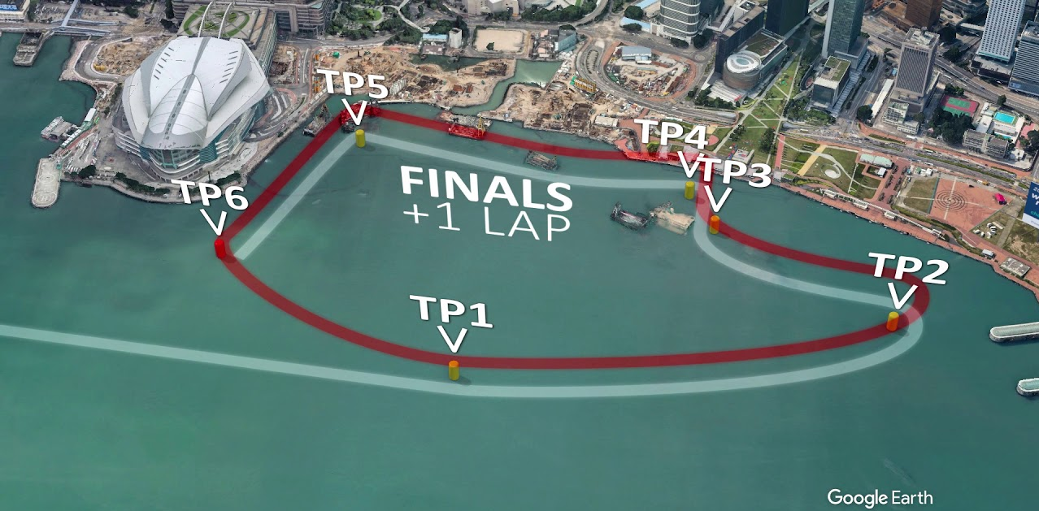
Time Trials Mode
Player attempts to beat their previous best time around a short, pre-set course.
Modes &
Mechanics
Exploratory
Training
Time Trials
Race
Objective
To provide a challenging environment which motivates the player to improve their performance.

Slide 16
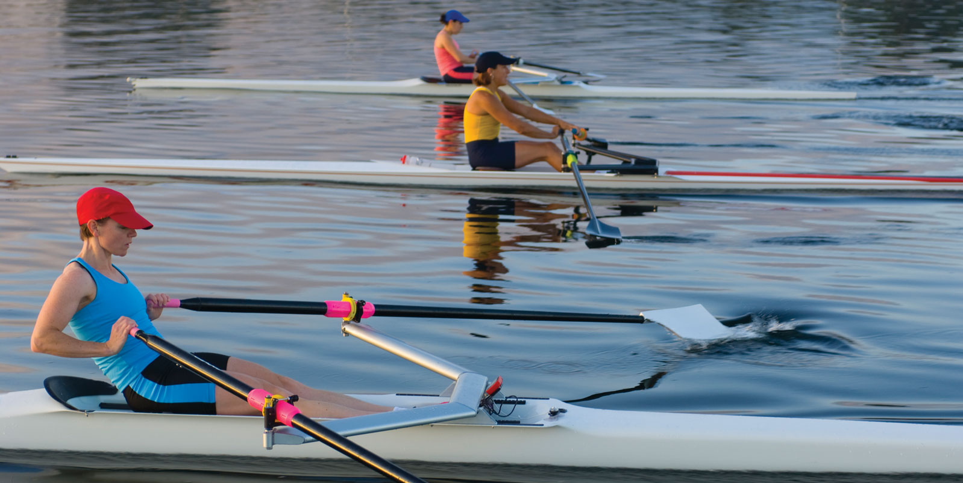
Race Mode
Player goes head-to-head against an AI competitor across a 500-meter sprint.
Modes &
Mechanics
Exploratory
Training
Time Trials
Race
Objective
To allow the player to test their training in a virtual competition.

Slide 17


Setting
Environment
Colour Palette

Slide 18
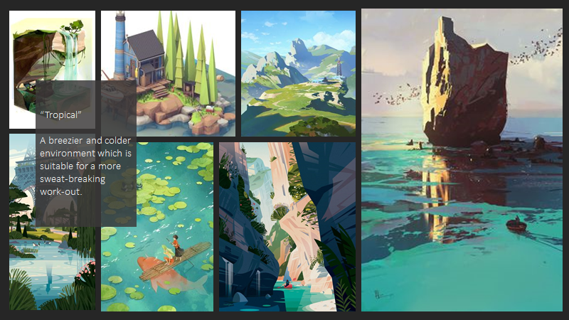
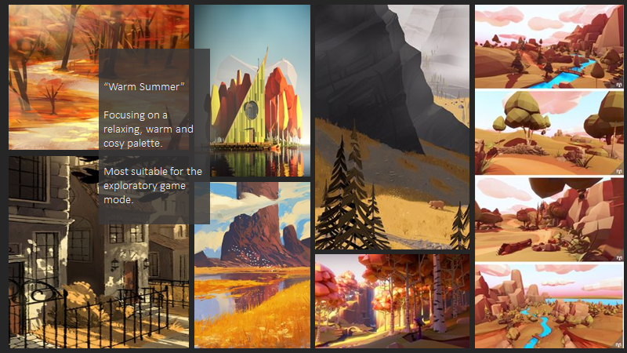
Setting
Environment
Colour Palette

Slide 19
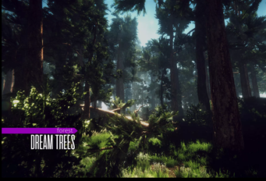
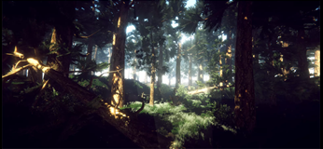
Game Assets
Dream Forest Tree
Book of the Dead
Simple Boids
Dynamic Nature
Free Asset Pack by IL.ranch

Slide 20

Game Assets
Dream Forest Tree
Book of the Dead
Simple Boids
Dynamic Nature
Free Asset Pack by Unity Technologies
Book of the Dead
Book of the Dead is a free asset pack released by Unity Technologies. The assets in this pack were created for the 'Book of the Dead' game.

Slide 21

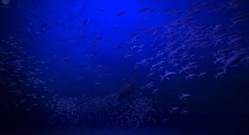
Game Assets
Dream Forest Tree
Book of the Dead
Simple Boids
Dynamic Nature
Free Asset Pack by Nicholas Veselov
NVJOB Simple Boids
A great pack to use in order to bring life into the game. It contains both the movement AI alongside models for birds, fish and insects. The flocking script offers random behaviour, reaction to danger, customization to flocking and promises to maintain good performance.

Slide 22

Game Assets
Dream Forest Tree
Book of the Dead
Simple Boids
Dynamic Nature
€45 Asset Pack by NatureManufacture
Forest Environment - Dynamic Nature
This pack contains a huge library of optimized scanned assets, shaders, textures, structures, roads and much more.

